Slide 1

Problem 9: Water Laser

Slide 2
A shallow water tank mechanically excited by a motor features some of the basic ingredients of a laser (i.e. a cavity and an amplifier). To what extent can this simple analogy capture more complex aspects of laser physics, such as spontaneous and stimulated emission, population inversion, Q switching, and others?

Slide 3
Parts of the problem statement
Cavity
Amplifier
Spontaneous emission
Stimulated emission
Population inversion
Q switching

Slide 4
What’s the big idea

Slide 5
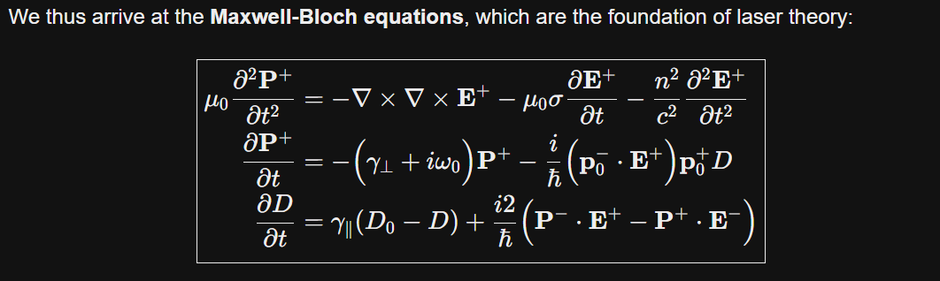
What’s the big idea

Slide 6
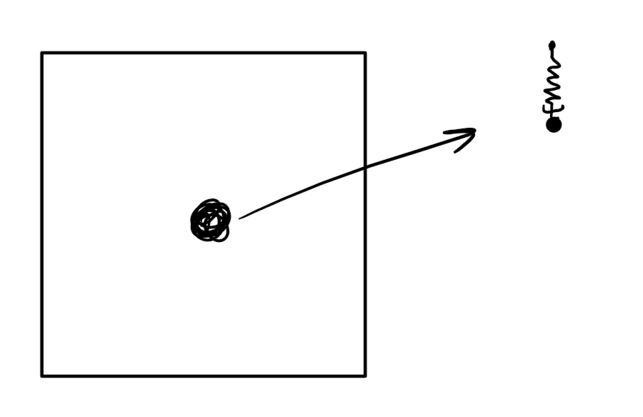
What’s the big idea
Instead: electrons modeled as damped, driven oscillators around the nucleus
Damping: roughly models atoms losing energy through heat or other phenomena.
Driving: Electrons are pushed by the electric field around them
Oscillating: Electrons are pulled toward the nucleus: a restoring force
For simplicity, I’ll group all atoms into one cluster, and think of them as a single “average” atom
Quantum effects are not as obvious

Slide 7
Emission and absorption: playing with the electron’s frequency
Emission:
Electric field gives the electron a kick (stronger than it “should”)
The electron oscillates in phase with the field
Adds energy back into the field
Absorption:
The electron oscillates out of phase with the field, destructively interfering with the wave
How? Idk maybe damping the oscillator so much that it lags behind the field

Slide 8
Balancing absorption and emission
The cluster acts in a weighted sum of both absorption and emission
Emitting atoms tend to become absorbing, unless they’re “pumped”
The stronger an atom emits, the more quickly it becomes absorbing
This creates an equilibrium

Slide 9
Applying the idea to the water tank
In water: the electric field becomes the water height, and the “atoms” contribute to the field by applying pressure to the water surface.

Slide 10
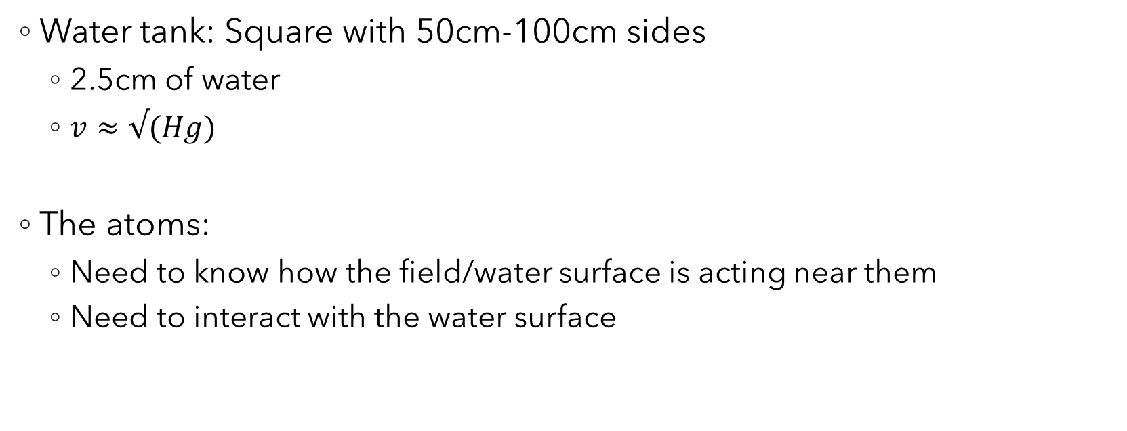
The design
Water tank: Square with 50cm-100cm sides
2.5cm of water
$v≈√(Hg)$
The atoms:
Need to know how the field/water surface is acting near them
Need to interact with the water surface

Slide 11
Interacting with the water surface
Full control of the water: nothing inside the water which the waves can bounce off of
Simplest way to do it (I think): applying localized pressure to the surface with air
How can you both push the water down and pull it up (as an electron would do to the electric field)?
Apply constant pressure and relieve it when you want to pull the surface up
Using a tiny, fast motor as a fan (with a funnel to focus air)
Needs to be very precise, the waves move fast
The oscillator will be purely digital, calculations in an arduino

Slide 12
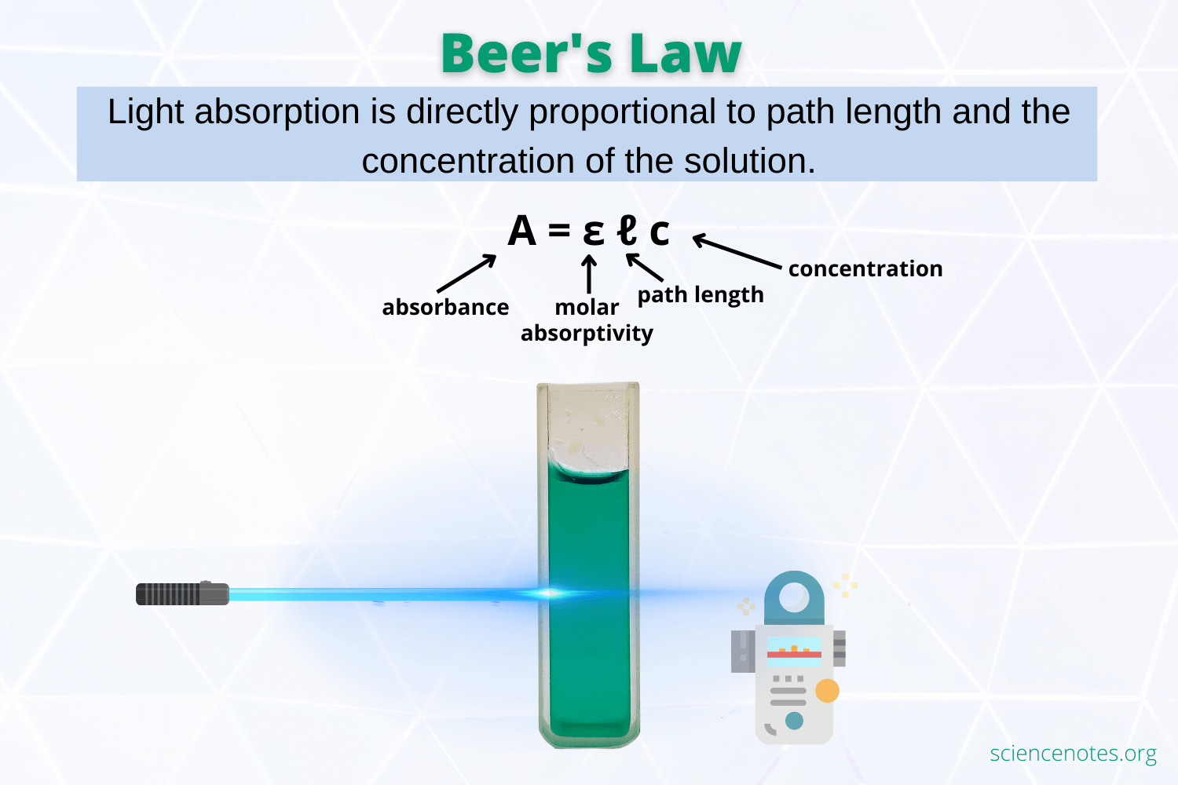
Reading the water height around the “atoms”
Again, don’t want to disturb the water surface
The water will be very thin
Solution:
Dye the water
Shine a light from the top
Record the intensity which makes it through to the bottom using a photodiode

Slide 13
Parts of the problem statement and their solutions

Slide 14
Cavity and Amplifier
Cavity: small volume where are the laser stuff happens
Amplifier: mechanism which uses energy to increase the amplitude of an electromagnetic wave
Solution:
Cavity: (most of) the water tank
Amplifier: photodiode/fan system

Slide 15
Emission: Spontaneous emission
Sometimes excited atoms randomly decay
This starts the chain reaction which leads a laser to “turn on” when the conditions are right
When the laser is on, it’s negligible
Solution:
Give my atoms a random kick sometimes?
Finger?

Slide 16
Emission: Stimulated emission
Described before, “emitting” atoms add energy back into the field when given a nudge.

Slide 17
Population inversion
Again described before, the balance between emitting and absorbing atoms
When there’s more emission than absorption, “population inversion” is reached

Slide 18

Q Switching
Emitting atoms tend to become absorbing, unless they’re “pumped”
The stronger an atom emits, the more quickly it becomes absorbing
This creates an equilibrium
If you don’t let the atoms emit while still pumping them, the equilibrium is broken and nearly all atoms become emissive
Solution:
Place a material around the edges of the tank which diffuses the waves

Slide 19

Simulation

